Slide 1

COVID 19 Prediction
DSC680 Course Project: Milestone 3 - Project Proposal Vasanthakumar Kalaikkovan

Slide 2
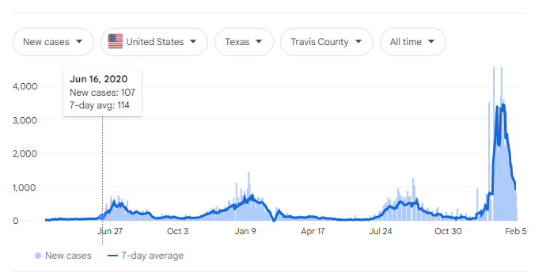
Background of the problem
COVID‑19 transmits when people breathe in air contaminated by droplets and small airborne particles containing the virus.
The risk of breathing these in is highest when people are near, but they can be inhaled over longer distances, particularly indoors.
Transmission can also occur if splashed or sprayed with contaminated fluids in the eyes, nose, or mouth, and, rarely, via contaminated surfaces.

Slide 3
Process Overview
Preliminary analysis on data
Data preparation and cleaning
Exploratory Data Analysis
Train and test models
Model evaluation and tuning

Slide 4
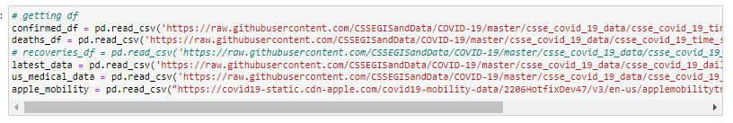
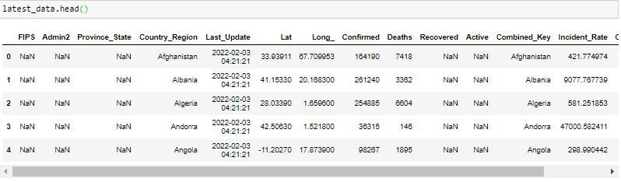
Data Preparation

Slide 5
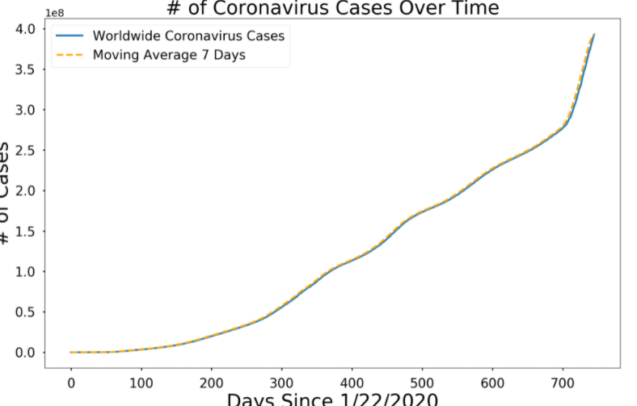
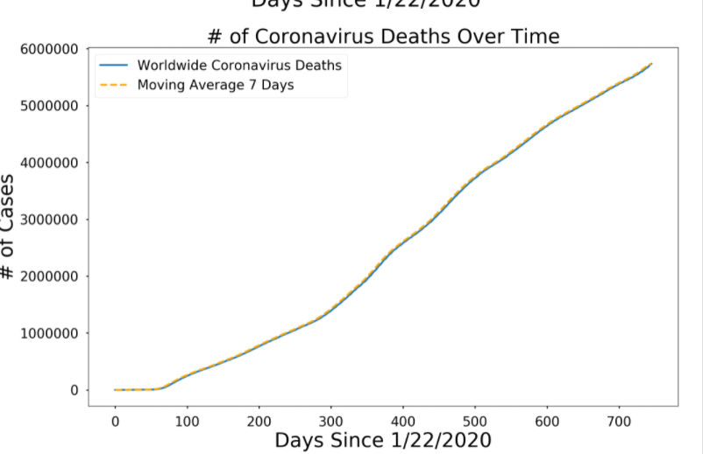
Exploratory Data Analysis (Number of cases)

Slide 6
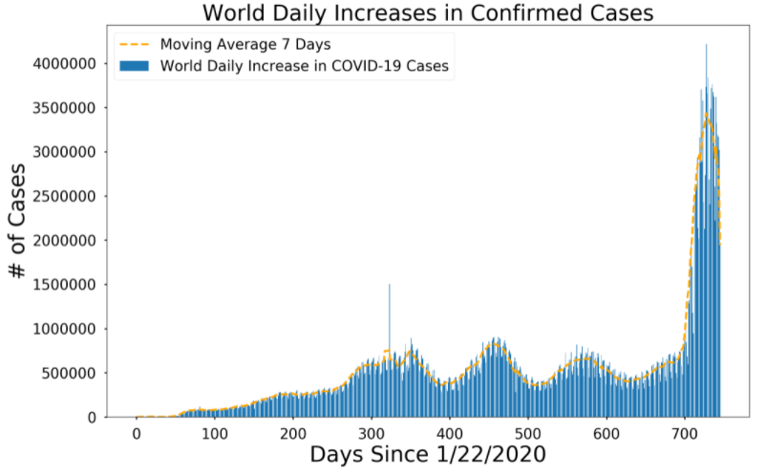
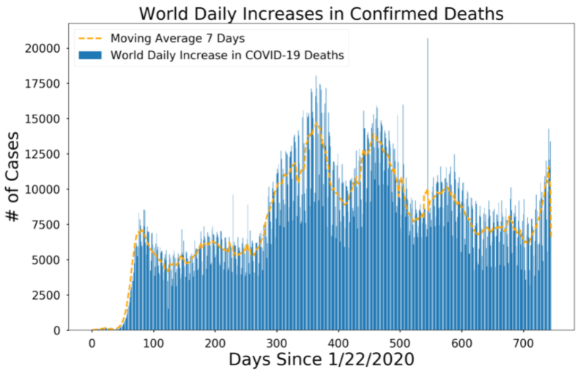
Exploratory Data Analysis (Increases in Cases)

Slide 7
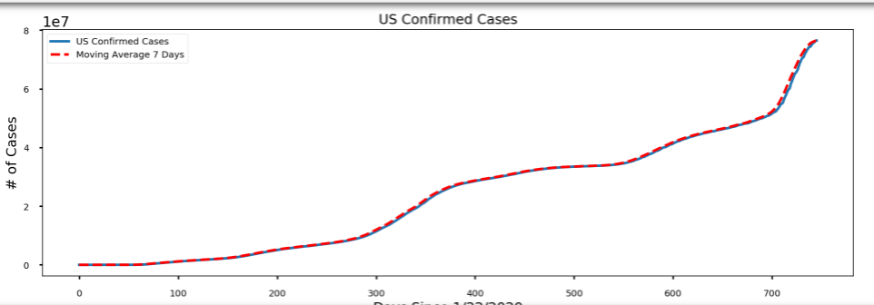
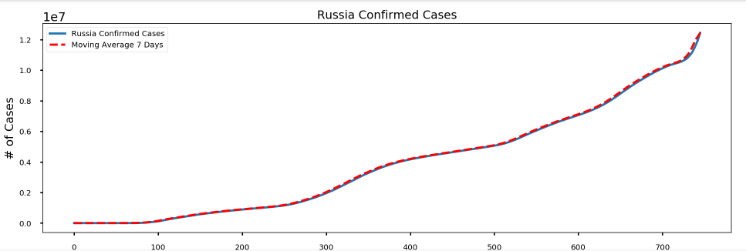
Exploratory Data Analysis (Cases country wise)

Slide 8
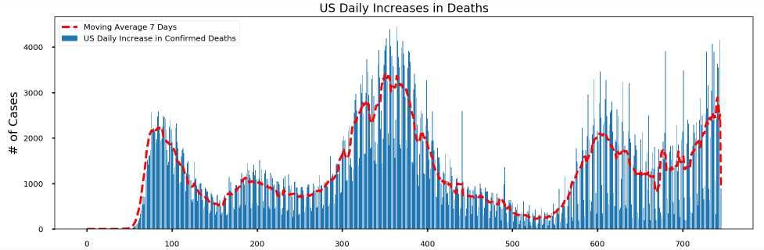
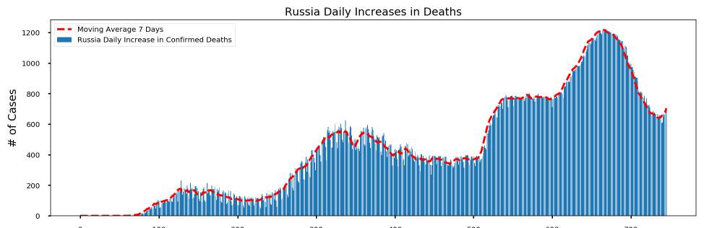
Exploratory Data Analysis (Country wise Deaths)

Slide 9
Data model
SVM – Support vector machines are supervised learning models with associated learning algorithms that analyze data for classification and regression analysis.
Polynomial regression – regression is to model a non-linear relationship between the independent and dependent variables. This is similar to the goal of nonparametric regression, which aims to capture non-linear regression relationships.
Bayesian Ridge – allows a natural mechanism to survive insufficient data or poorly distributed data by formulating linear regression using probability distributors rather than point estimates. The output or response ‘y’ is assumed to be drawn from a probability distribution rather than estimated as a single value.

Slide 10
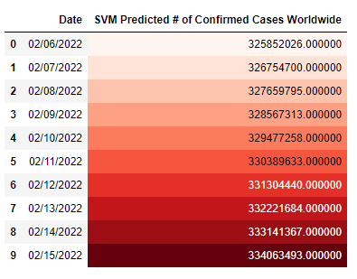
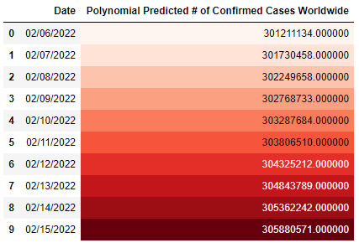
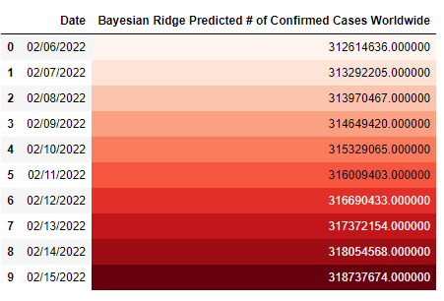
Model Prediction

Slide 11
Conclusion
After completing the project, we compared the results with apple mobility’s prediction and its almost 90% accuracy.
We can deploy this project in some server and get the result as API using libraries so that we can deploy this project in any platform to get the results.

Slide 12
Reference
COVID-19 - Wikipedia
Coronavirus (COVID-19) Visualization & Prediction | Kaggle
Polynomial regression – Wikipedia

Slide 13
Thankyou

